Slide 1
“REAL-TIME ANALYSIS AND ENHANCEMENT OF ATHLETE TRAINING BASED ON HAR, OPEN CV AND DEEP-LEARNING MODEL”
Project Guide | Project Coordinator | Team Members
Mr. Shashank Tiwari Assistant Professor | Mrs. G. Sri Sudha Assistant Professor | Ch. Hiranmayi (21AG1A66F0) M PaulJohn (21AG1A66F9) P John Ricky (21AG1A66G7)

Slide 2
Agenda
Abstract
Introduction
Literature Survey
Existing System
Proposed Methodology
Research Gaps
Architecture
Algorithm
UML Diagrams
Requirements
Results
Conclusion

Slide 3
Abstract
The proposed system enhances football players' performance by leveraging advanced technologies like Human Action Recognition (HAR), AI, and Deep Learning. It evaluates player movements to improve critical aspects such as shooting accuracy, optimal angles, and positioning. Datasets derived from videos or images help identify technical errors and provide actionable recommendations. Tools like OpenCV ensure accurate movement analysis, while YOLOv8 delivers real-time precision in detecting and classifying attributes. Advanced algorithms like Artificial Neural Networks (ANNs) are employed to extract and analyze relevant features. Python programming and open-source libraries form the core of the system. Development is carried out using IDEs like Visual Studio Code and Google Colab. This holistic approach provides personalized insights for players and teams. It optimizes gameplay efficiency and helps achieve performance goals through data-driven analysis. The system transforms traditional football training into an AI-powered process.

Slide 4
Introduction
The integration of AI and computer vision technologies is revolutionizing football training and performance analysis. By leveraging advanced tools like Human Activity Recognition (HAR), CNNs, and YOLOv8, the system offers precise analysis of player movements, strategies, and game dynamics. OpenCV ensures accurate mobility assessment, while Python and open-source libraries power the implementation, developed using IDEs like Visual Studio Code and Google Colab. This AI-driven system identifies technical errors, evaluates shooting angles, and provides actionable insights to enhance player performance and optimize team strategies. By minimizing errors and improving success probabilities, it transforms how football is analyzed and played in the modern era.

Slide 5
Literature Overview
Paper Title | Author Name(s) | Proposed Methodology | Findings
"Detecting and Tracking Soccer Balls using YOLOv7 and DeepSORT" | Vicente-Martinez et al [1] | Enhanced YOLOv7 architecture with a focal loss function to improve detection accuracy. Introduces a semi-supervised learning framework with 6331 images to reduce reliance on fully labeled data. | The proposed system achieves 95% precision and outperforms previous methods, especially under occlusions and fast motion.
"Automatic Classification and Tracking of Basketball Players and Ball Movements" | Y. Yoon et al [2] | Utilizes YOLO and Darknet CNNs for real-time player identification. Leverages movement history to improve tracking accuracy and applies network science for analyzing player relationships. | Improves tracking accuracy despite challenges like player overlap and dynamic camera angles. Assesses player importance using multivariate Eigen centrality.
"Predicting Success of Three-Point Shots using RNNs" | R. Romijnders et al [3] | Uses Recurrent Neural Networks (RNNs) to model sequences of player and ball tracking data. Compares RNN performance with traditional ML models. | RNN model achieves an AUC of 0.843, outperforming traditional ML models, demonstrating the potential of deep learning in sports analytics.
"Enhancing Action Recognition Accuracy with 3D CNN and Spatial Attention" | Wenxin Du et al [4] | Develops a dual-channel 3D CNN integrated with a spatial attention mechanism (SA) for athlete action recognition. Processes inter-frame difference information alongside grayscale video data. | Recognition accuracy remains above 87.5% even with 400 incorrect actions, supporting athlete training with objective performance assessment.
"AI and Computer Vision for Squat Performance Improvement" | M. Chariar et al [5] | Proposes a stacked Bi-GRU model with an attention layer for accurate squat classification and correction. Uses MediaPipe for pose estimation and compares Bi-GRU with state-of-the-art methods. | The model classifies squats into seven categories with 94% accuracy, providing personalized corrections based on body proportions for safer workouts.

Slide 6
Existing System
The existing systems in sports analytics and motion tracking primarily rely on deep learning models such as YOLO, RNNs, and CNNs to improve accuracy in player and ball tracking, action recognition, and performance assessment. YOLOv7 with DeepSORT achieves 90% precision in soccer ball tracking, while YOLO and Darknet CNNs enhance basketball player and ball classification despite challenges like occlusions and dynamic camera angles. RNNs outperform traditional models in predicting three-point shot success, achieving an AUC of 0.843. Additionally, a dual-channel 3D CNN with spatial attention maintains 87.5% accuracy in action recognition, and a Bi-GRU model with an attention mechanism classifies squat performance with 90% accuracy. However, existing methods face limitations, including dependence on labeled data, sensitivity to occlusions and motion blur, and limited real-time adaptability in dynamic sports environments.

Slide 7
Proposed Methodology
The proposed methodology enhances sports analytics by integrating advanced deep learning models such as YOLOv8, overcoming occlusions and motion blur, while ByteTrack improves multi-object tracking for accurate player and ball movement analysis. To enhance trajectory prediction, model player interactions, while incorporating real-world movement constraints. For action recognition, with attention mechanisms and improved motion tracking and biomechanics assessment. To reduce reliance on labeled datasets, Contrastive Learning enables self-supervised learning, and Vision-Language Models (e.g., SIGLIP) enhance contextual understanding of player strategies. A real-time AI-based decision support system is developed edge computing for low-latency processing, while UMAP techniques provide interpretable insights for coaches and analysts. This approach ensures improved tracking accuracy, real-time adaptability, reduced data dependency, and enhanced biomechanical assessment, making it a more effective and scalable solution for sports analytics.

Slide 8
Research Gaps
Real-time feedback mechanism
Insufficient results in tailoring techniques and recommendations based on individual athlete performance.
2. Effectives of Visualization Techniques
Visualization of performance data can enhance learning and technique improvement.
3. Integration of multi-modal data
Combining data such as wearable sensors and video analysis from various sources to understand more accurately.

Slide 9
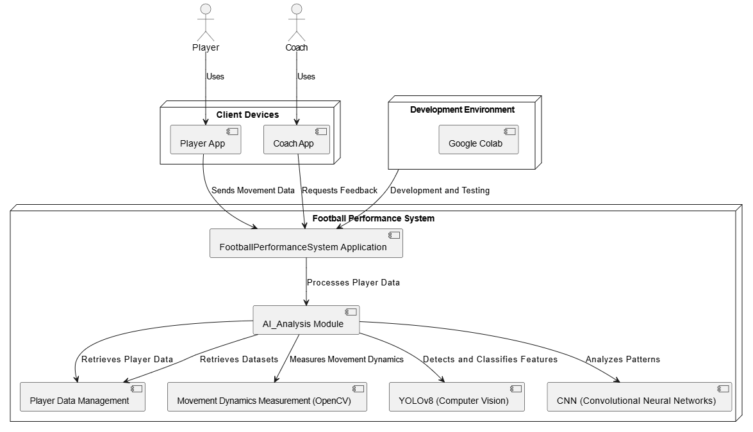
Architecture

Slide 10
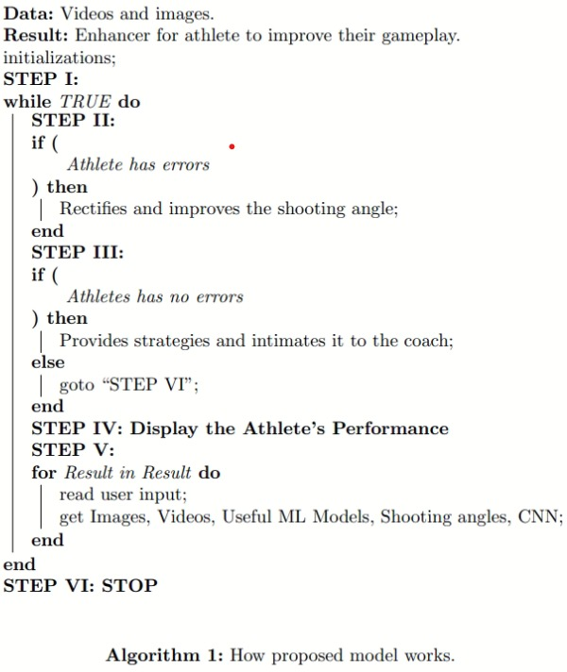
Algorithm

Slide 11
UML Diagrams

Slide 12
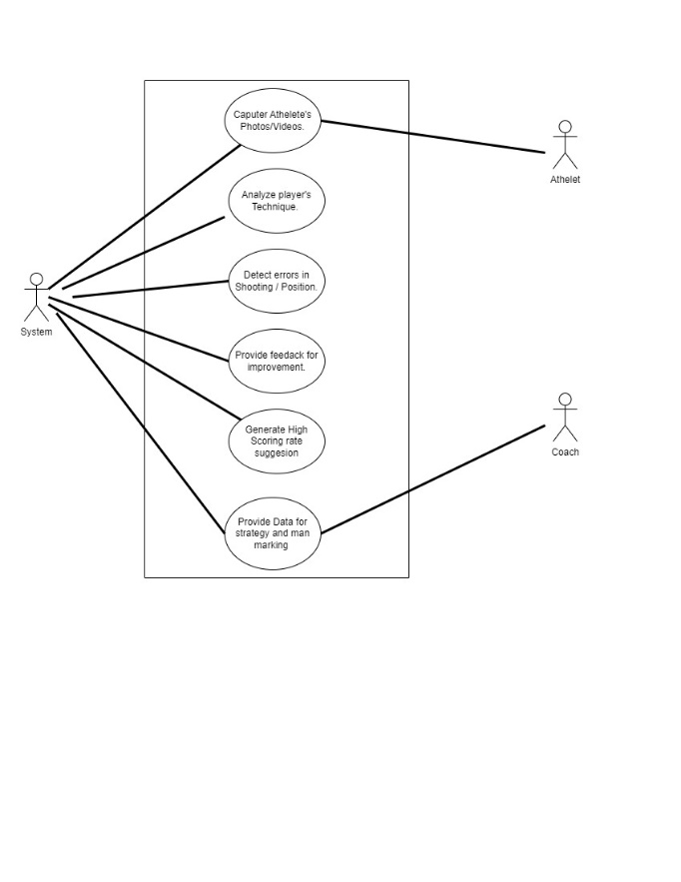
Use Case Diagram

Slide 13
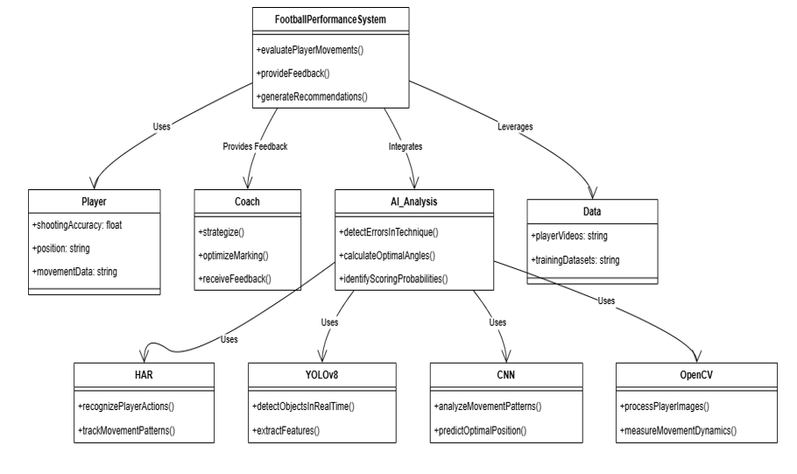
Class Diagram

Slide 14
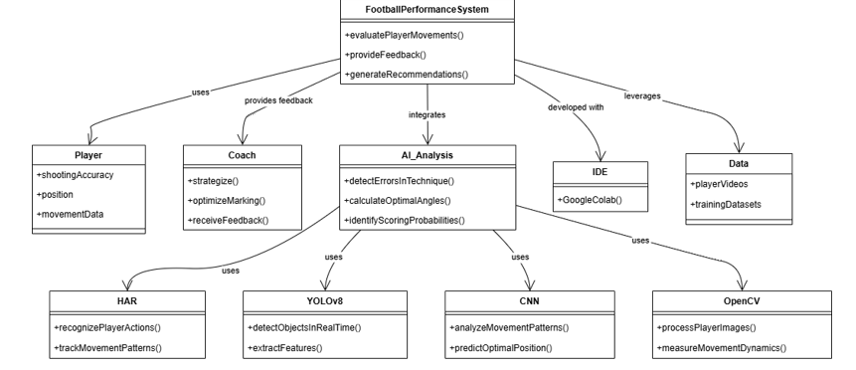
Object Diagram

Slide 15
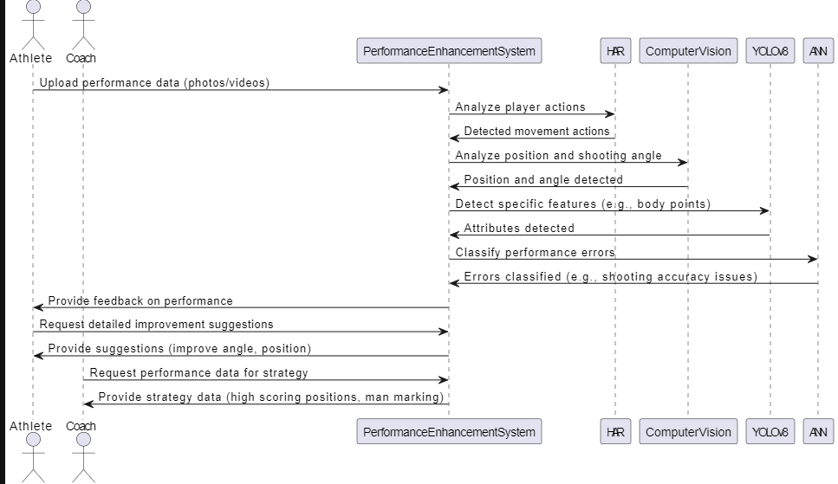
Sequence Diagram

Slide 16
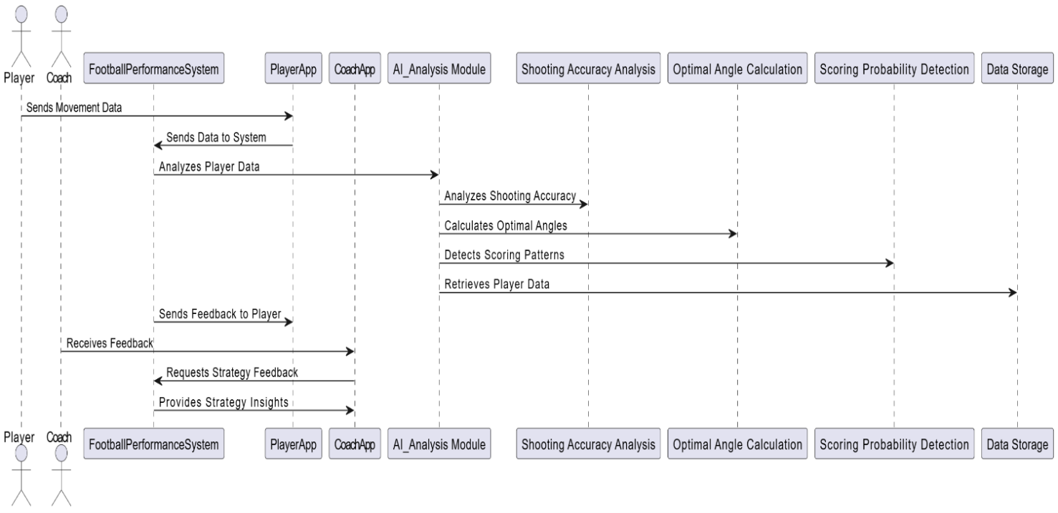
Collaboration Diagram

Slide 17
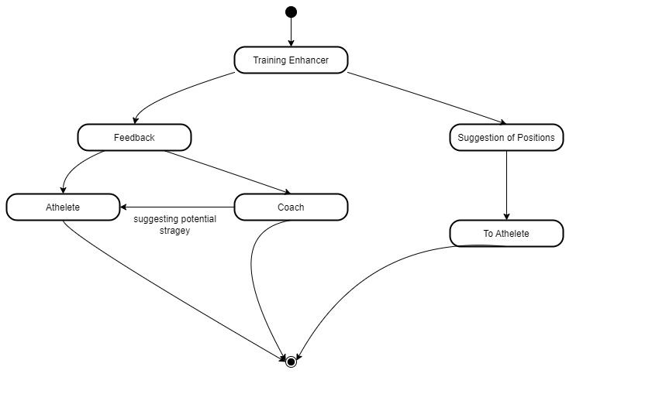
State Chart Diagram

Slide 18
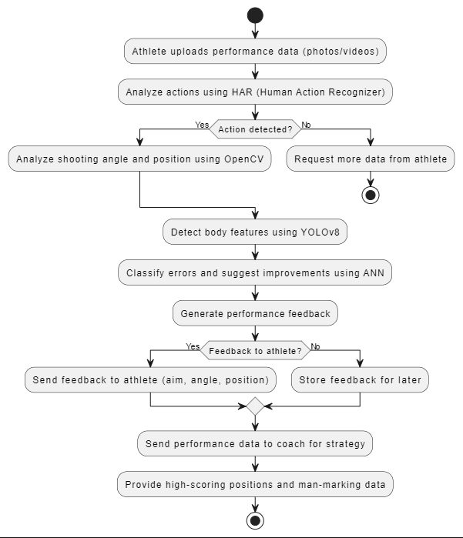
Activity Diagram

Slide 19
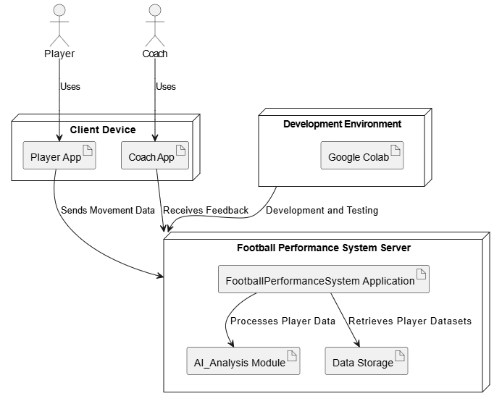
Deployment Diagram

Slide 20
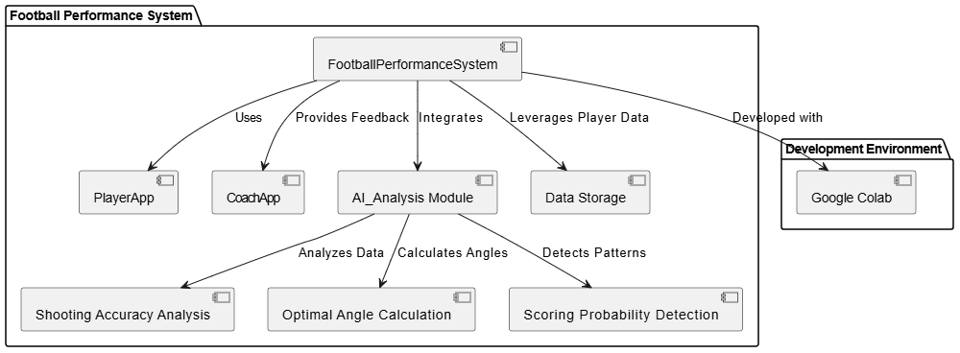
Component Diagram

Slide 21
Resources
Data sets | Software Resources | Hardware
Universe.roboflow 372 high quality images Covering a range of football scenarios | Google collab Python libraries Yolov8 model | Processor i5 4gb ram Internet connection

Slide 22
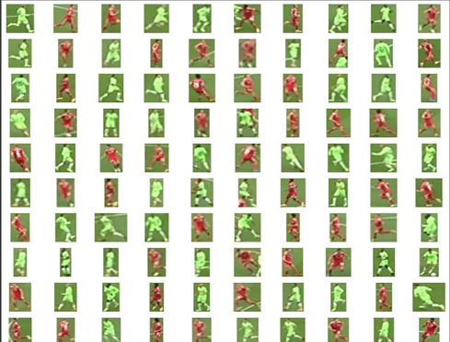
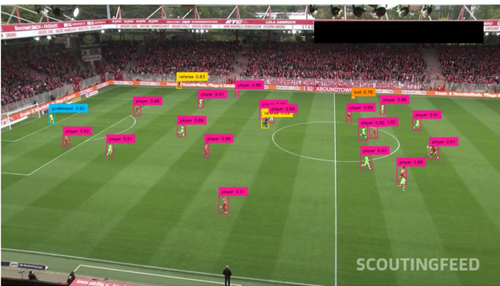
Results

Slide 23
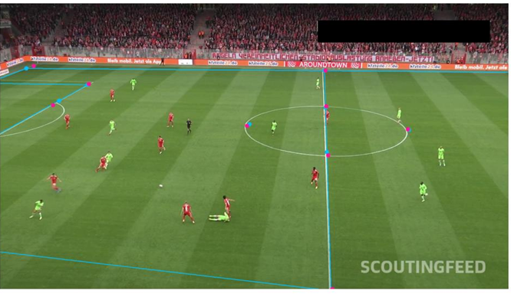
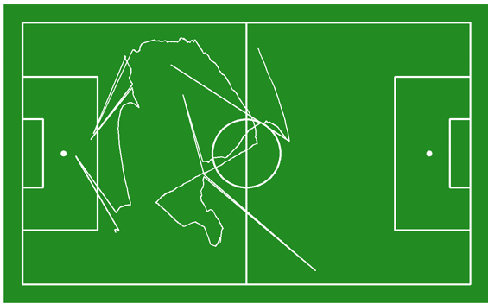
Results

Slide 24
Conclusion
.
In conclusion, this study demonstrates the transformative potential of integrating advanced technologies such as Human Action Recognition (HAR), Artificial Intelligence (AI), and Deep Learning into football training and performance analysis. By leveraging these tools, the system offers a comprehensive approach to enhancing key aspects of players' techniques, including shooting accuracy, optimal positioning, and decision-making. The use of cutting-edge algorithms like YOLOv8 and Artificial Neural Networks (ANNs) enables precise and real-time analysis, providing actionable insights that are crucial for refining skills and developing effective strategies

Slide 25
Thank you

